Slide 1


Turning Your Book into a Game: Improving Motivation through Tangible Interaction and Diegetic Feedback in an AR Mathematics Game for Children
Paper Review
Zelli Ghea Mardi Anugrah (6025222014)
TD – Interaksi Manusia dan Komputer

Slide 2
Turning Your Book into a Game: Improving Motivation
through Tangible Interaction and Diegetic Feedback in an
AR Mathematics Game for Children
Jingya Li, Erik D. van der Spek, Jun Hu, Loe Feijs
CHI PLAY'19, October 22–25, 2019, Barcelona, Spain
Background
Children often experience mathematics as a difficult subject during primary school years, which makes the learning motivation and engagement an important factor in their mathematics performance, The increased motivation and active engagement in AR games can potentially translate to compelling educational media and make learning more enjoyable and immersive for children.
What is purpose of this paper?
investigate how different interaction techniques (digital screen-touch interaction vs real-world tangible interaction) and different feedback mechanisms (non-diegetic feedback vs diegetic feedback) affect 7-8-year-old children’s motivation for mathematics learning
TD – Pengujian perangkat lunak

Slide 3
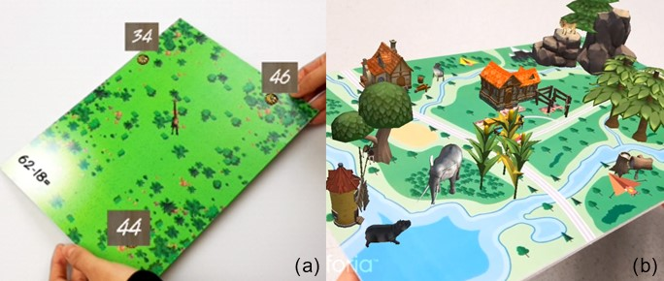
TD – Pengujian perangkat lunak

Slide 4
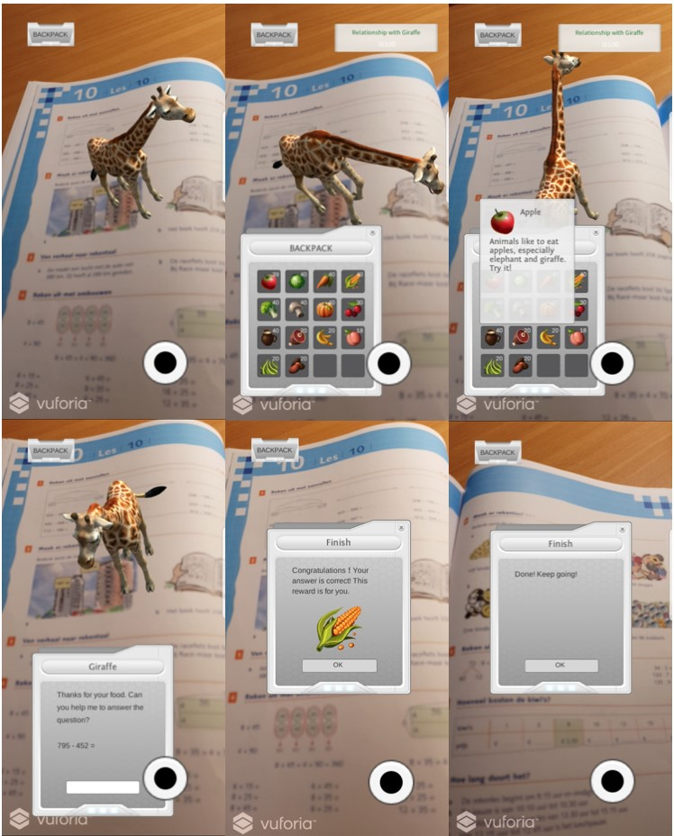
INTERACTION TYPE
TD – Pengujian perangkat lunak

Slide 5
INTERACTION TYPE
Through
children’s manipulation of a physical textbook
Screentouch Interaction
Real-world tangible interaction
TD – Pengujian perangkat lunak

Slide 6
INTERACTION TYPE
through digital touchscreen
Real-world tangible interaction
Screentouch Interaction
TD – Pengujian perangkat lunak

Slide 7
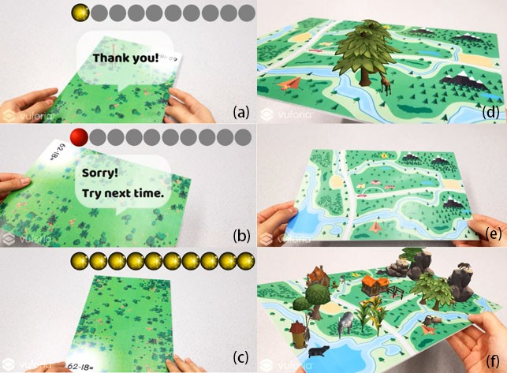
FEEDBACK MECHANISM
Progress Bar
Progress Map
TD – Pengujian perangkat lunak

Slide 8
Key Point Regarding This Research
1
Motivation in AR Learning Games, it believes AR could make learning more motivating and engaging compared to traditional learning games
2
Interaction Types, Screen-touch is most common interaction technique used in AR games, Tangible is also used however challenges and limitations remain in these tool
3
Feedbaack Mechanisms, Feedback lets players know where they are in the game process. Diagetic or non-diagetic
4
Self-determination Theory, theoretical frameworks for intrinsic motivation research in video games. Three basic psychological and intrinsic needs, namely the need for competence, the need for autonomy, and the need for relatedness
TD – Pengujian perangkat lunak

Slide 9
Design Process & Prototype
Co-design with Children
User Tests of the Base-game Prototype
Game Design
The game is developed in unity using Vuforia
Evaluation
Co-design with two primary school children aged 7-year-old (males) in 4 session
tests were conducted comparing this AR-based game with a traditional paper exercise
Design the game based on findings
insights:
children like the ideas of animals walking on top of the book and expect the interactions to be rich;
the game should include exercises with different difficulty levels to be suitable for different mathematics skills
no significant difference between the paper or AR game on their exercise scores, showing that the AR game did not have negative influence on children’s performance in doing exercises. It also make learning more fun
TD – Pengujian perangkat lunak

Slide 10
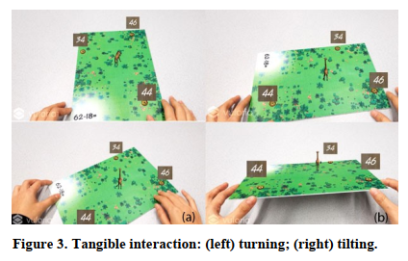
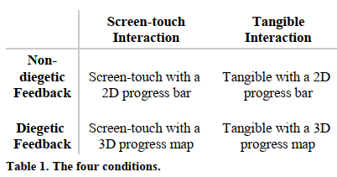
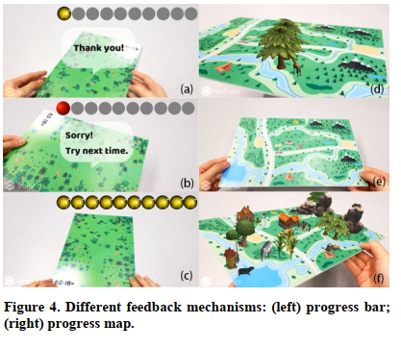
Game Design
The game is designed using below condition
TD – Pengujian perangkat lunak

Slide 11
Game Mechanic
Children find animal from book
Children interact with said animal
If the animal “satisfied” math problem is appear
If answer is wrong. Progress bar decrease (via diagetic or non-diagetic)
If answer is right. Progress bar increase (via diagetic or non-diagetic)
TD – Pengujian perangkat lunak

Slide 12
USER STUDY
impact of the different interaction techniques and feedback mechanisms in AR game on the perceived competence, autonomy, relatedness, and the enjoyment level
Participant : 32 children participated in the study (16 males, 16 females) between the ages of 7 and 8
Questionnaire : Player Experience of Need Satisfaction Questionnaire (PENS)
Enjoyment : adapted from the Intrinsic Motivation Inventory (IMI)
1
Scales for competence to assess the perceived efficacy playing the game
bipolar 7-point Likert scale where 1 represents “strongly disagree” and 7 represents “strongly agree”.
2
Autonomy to assess the sense of self-determined behaviors
3
Relatedness to assess the sense of social connection*
* Later not included
TD – Pengujian perangkat lunak

Slide 13
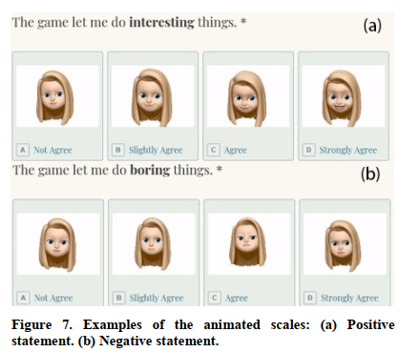
USER STUDY
TD – Pengujian perangkat lunak

Slide 14
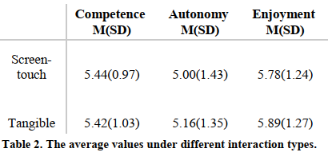
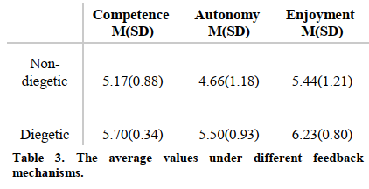
USER STUDY
TD – Pengujian perangkat lunak

Slide 15
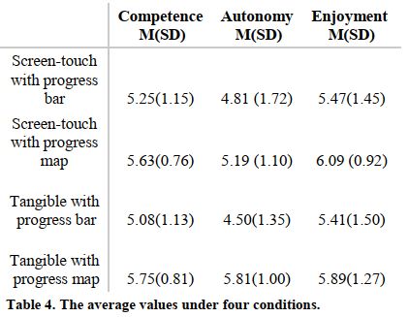
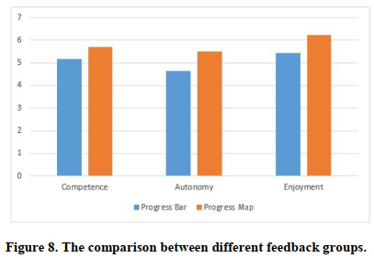
USER STUDY
TD – Pengujian perangkat lunak

Slide 16
Interview Result
Which version do you prefer?
screen-touch | tangible interaction | No Difference
7 children | 17 Children | 8 Children
Why do you like the screen-touch interaction?
screen-touch | tangible interaction
it’s much easier and faster | it’s too difficult to control
Why do you like the tangible interaction ?
screen-touch | tangible interaction
“the other one is boring” | “because it’s so interesting”; “when I figured out how it really works it’s really fun to play “
TD – Pengujian perangkat lunak

Slide 17
Discussion
1
Results indicate no significant differences between the two examined interaction types (screen-touch vs tangible) in terms of perceived competence, perceived autonomy, and enjoyment level
2
Screen-touch interaction requires less effort but can make some children feel bored, while the tangible interaction has the potential to motivate children
3
Tangible interaction requires children to practice in order to grasp the precise and somewhat cumbersome controls of this interface
TD – Pengujian perangkat lunak

Slide 18
Conclussion
This study the author investigated how children 7-8 years old react to two different interactions styles (screen-touch versus tangible interaction) as well as two different feedback mechanisms (a non-diegetic progress bar versus a diegetic progress map). There was a significant effect of feedback mechanisms on motivation while playing the game. There was no significant effect of screen-touch or tangible interaction on motivation, and no significant interaction effect between feedback and interaction type
TD – Pengujian perangkat lunak

Slide 19
TERIMA KASIH
2
Any Question?
TD – Interaksi Manusia dan Komputer
Email : 6025222014@mhs.its.ac.id / WA : 082253652763

